Slide 1

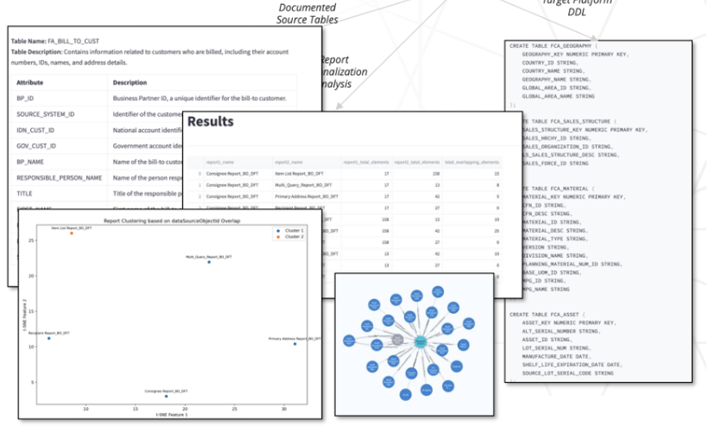
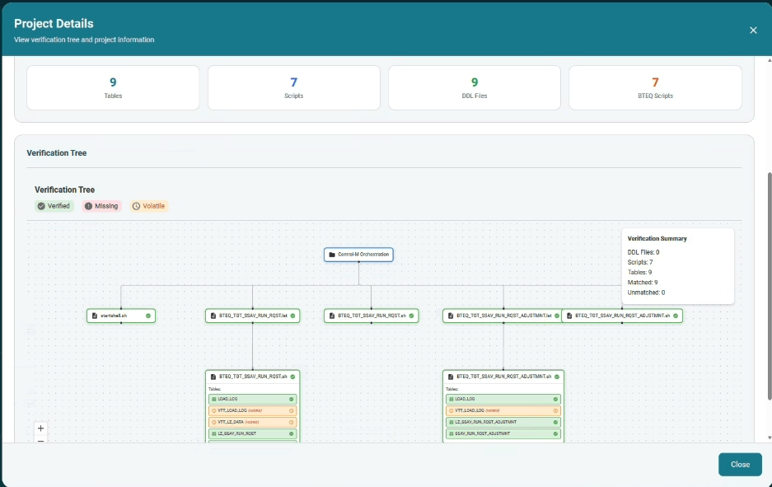
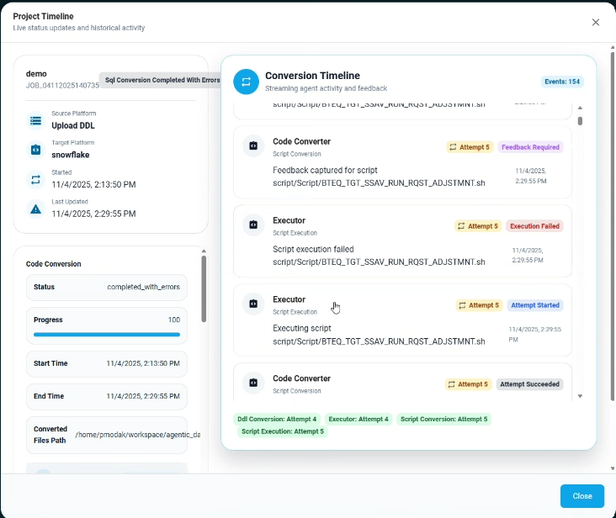
Report Rationalization
Migration Phase
1
Report Rationalization Data Assist - DRECT
Reverse engineers the BTEQ, Informatica code, Control-M and database metadata to identify object dependency, generate source to target mapping and lineage.
DDL Migrator Agent
Converts Teradata DDL scripts into Snowflake DDL scripts
Code Converter Agent
Converts BTEQ, Informatica code into Snow-SQL
Data Migration Agent
Generates configuration for the bulk upload to Elevance Health built data ingestion framework Falcon
Testing Agent
Generates and executes test cases for DDL, BI/SAS reports, data during SIT, UAT and Regression testing
Code Optimization Agent
Code optimization agents monitors queries and recommends ways to optimize for performance and cost.
Data Assist 3.0 - DRECT
Data Assist 3.0- Migration Agents
Data Assist 3.0 -Optimization Agent
2
Identify reports which need to be considered for migration
1
Report Rationalization
2
3
4
5
6
DDL Migrator Agent
Data Code Converter Agent
Report Migration Agent
Testing Agent: Data & Reports
Code Optimization Agent
Team of helper agents & tools
3
Data Assist 3.0
(Code Converter, CATE, Report Migrator, Report Validator , Code Optimizer)
4
Convert table, views DDL definitions of of the custom objects required by reports finalized by
Convert SQLs, Stored procedures, Packages, Triggers from custom data layer set up for reports to target MS SQL & Databrick platform
Validates data objects migrated(if any) for row count, metrics and generates report
5
Inventory Dependency Tracker
6
Track Agentic Conversion Progress

Slide 2
